Slide 1
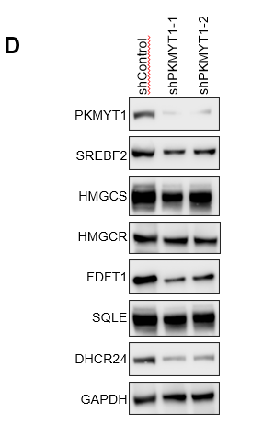
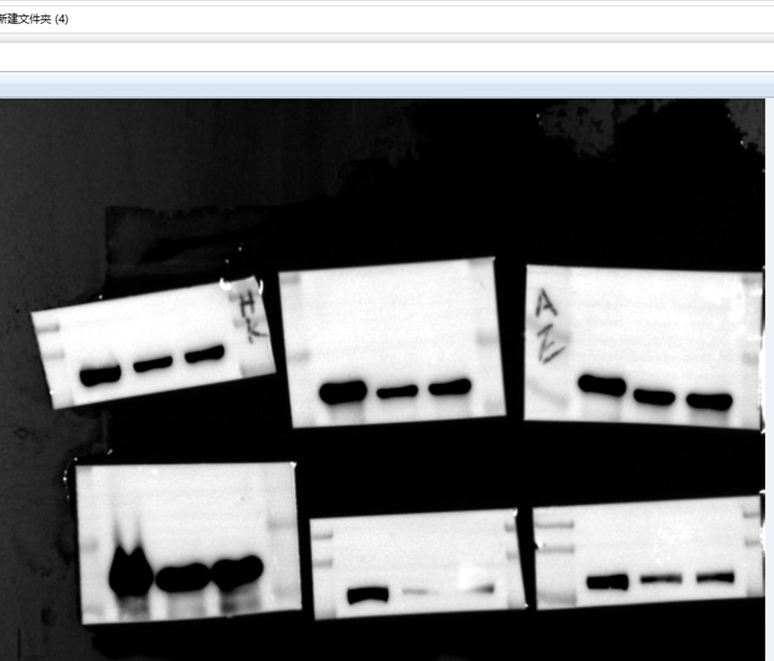
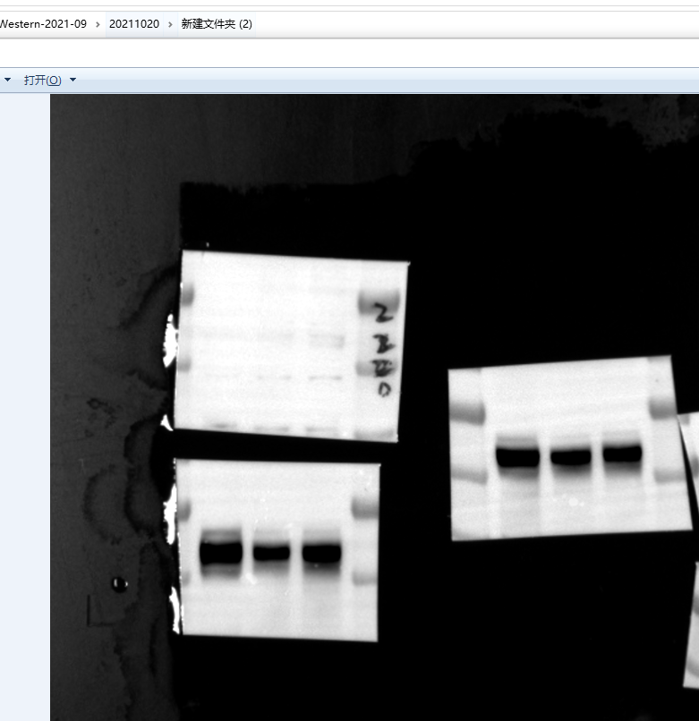
Fig 2D
HMGCR
HMGCS1
SQLE
FDFT1
FDFT1
Srebf2
SQLE
DHCR24
HMGCS
DHCR24
PKMYT1
PKMYT1
Vinculin

Slide 2
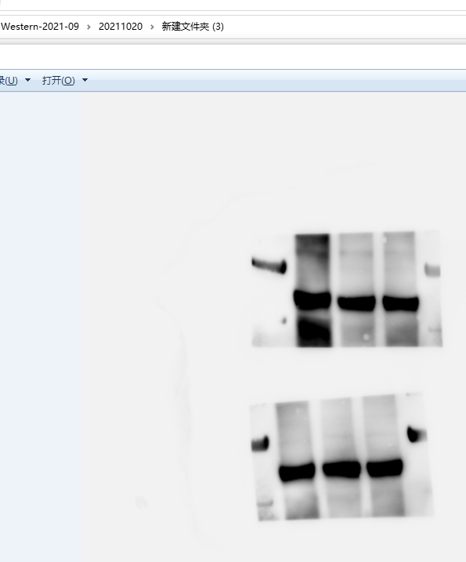
Fig 2D
HMGCR
GAPDH

Slide 3
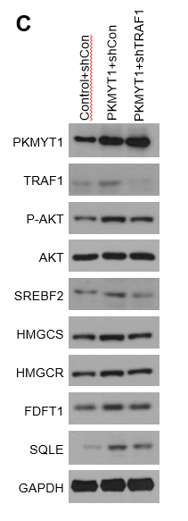
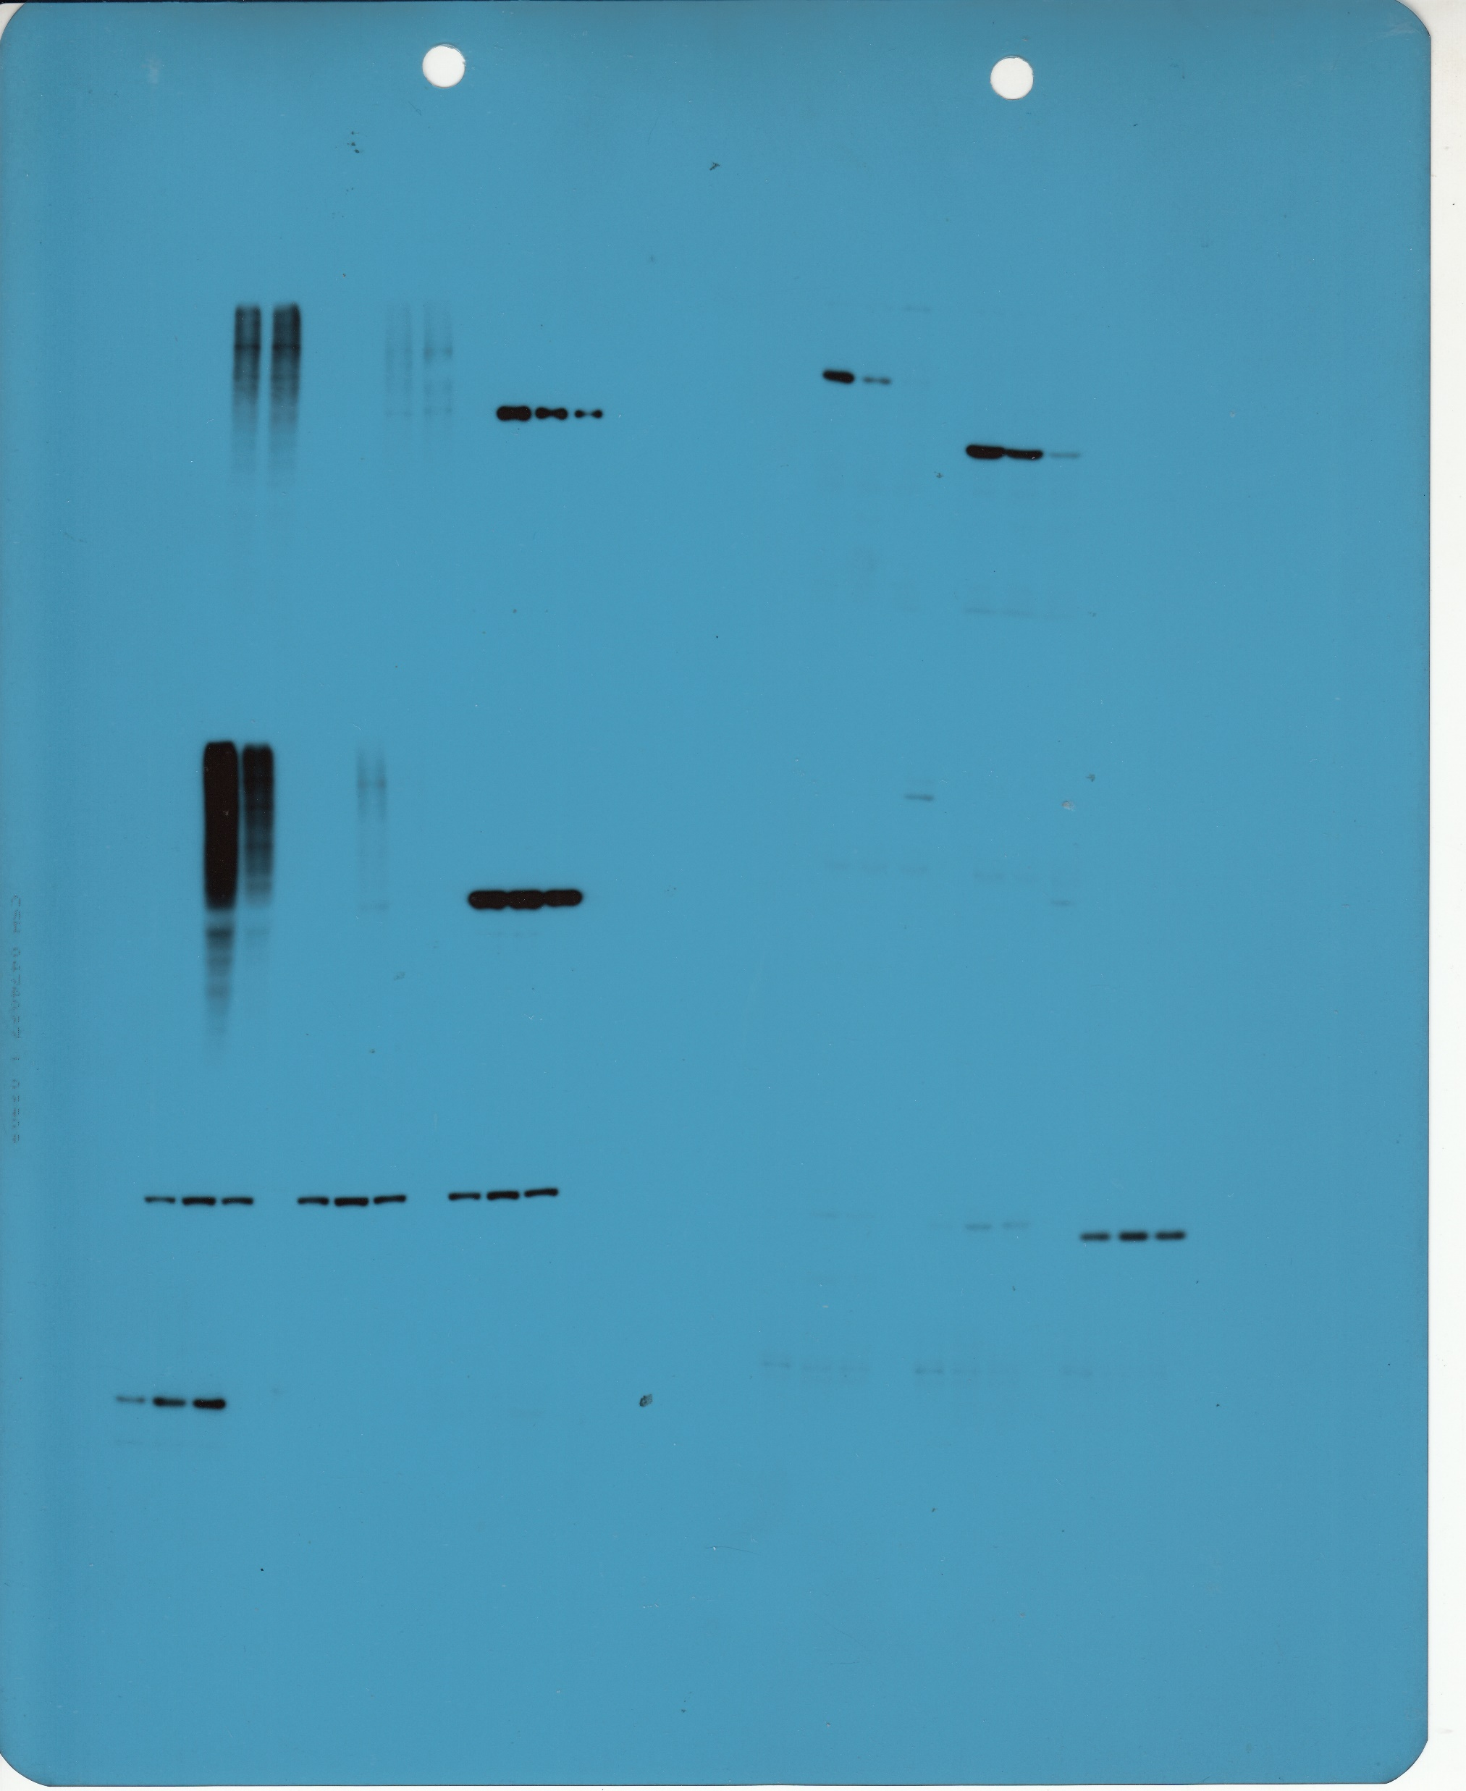
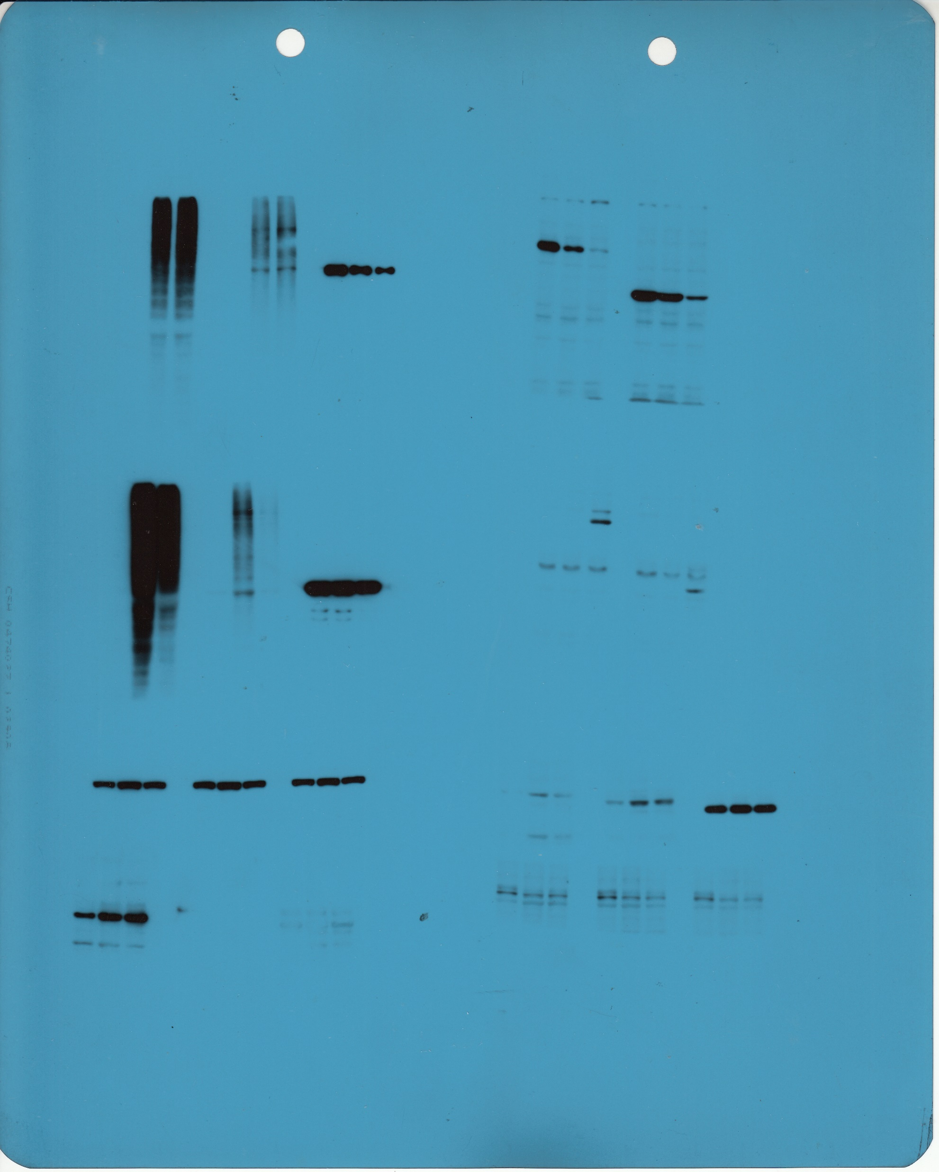
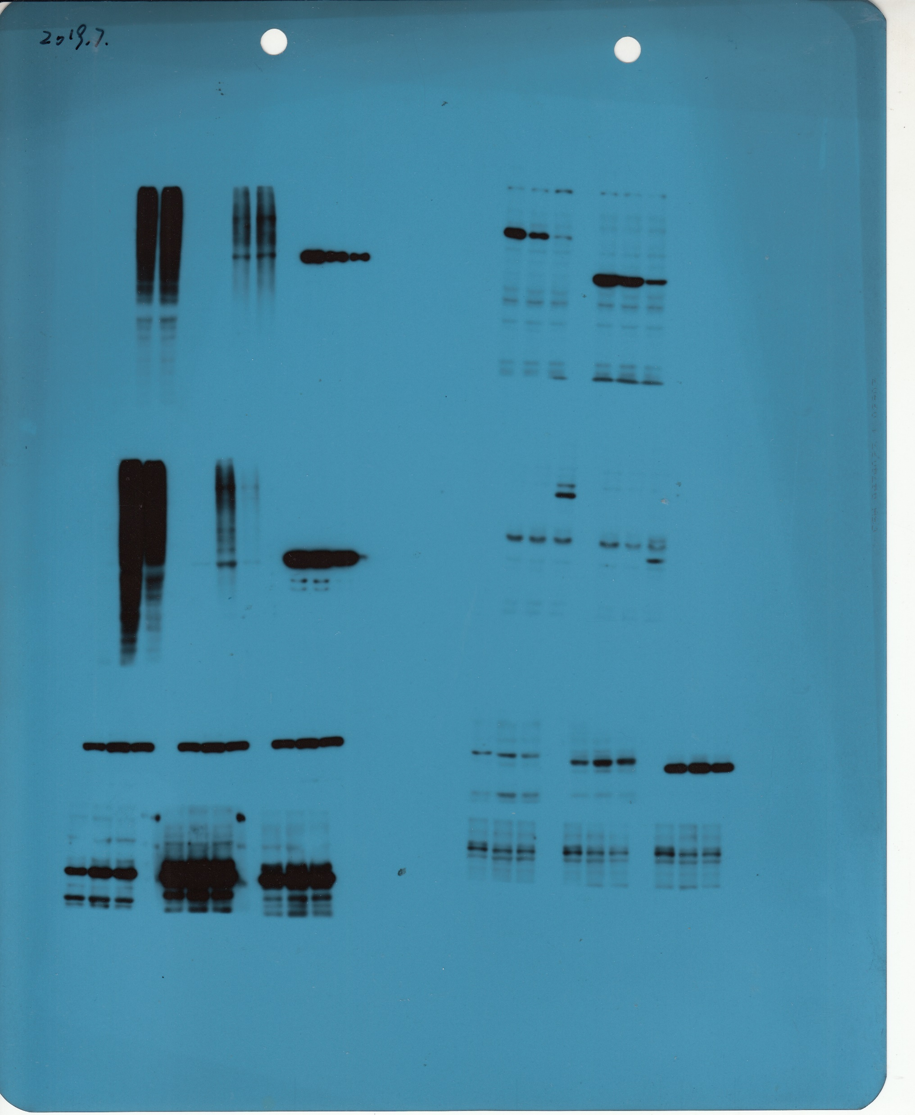
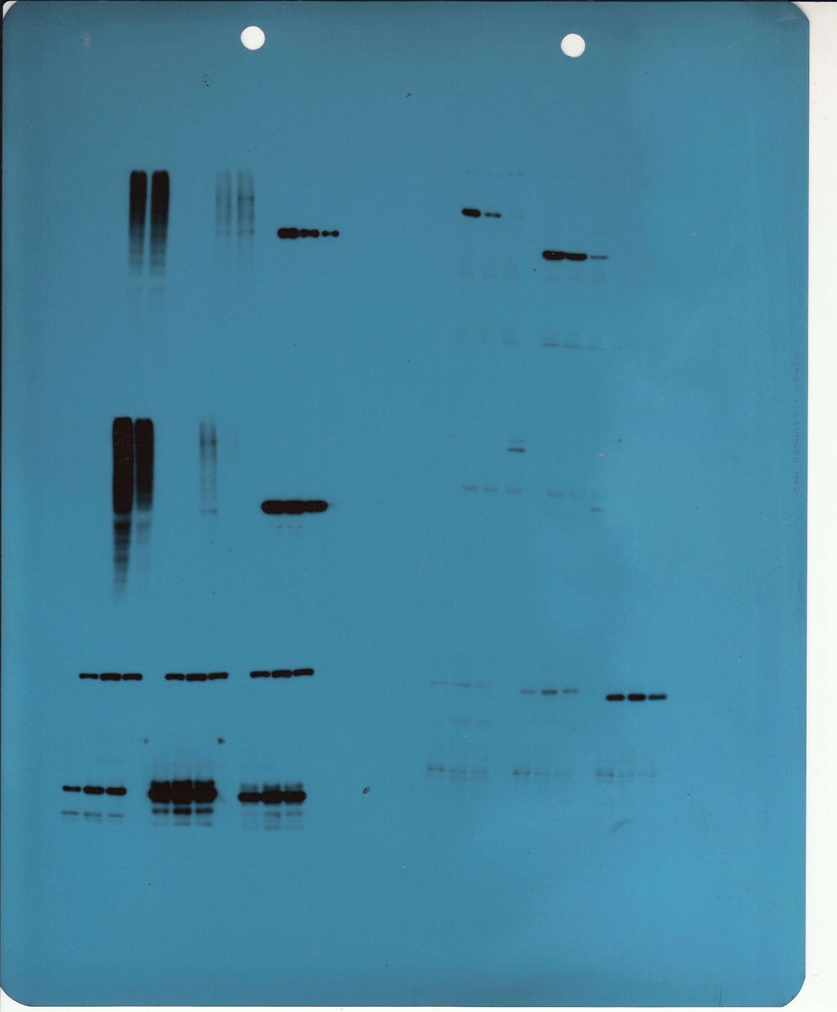
Fig3 C
P-AKT
SQLE
SREBF2
HMGCR
FDFT1
HMGCS1
TRAF1
PKMYT1

Slide 4
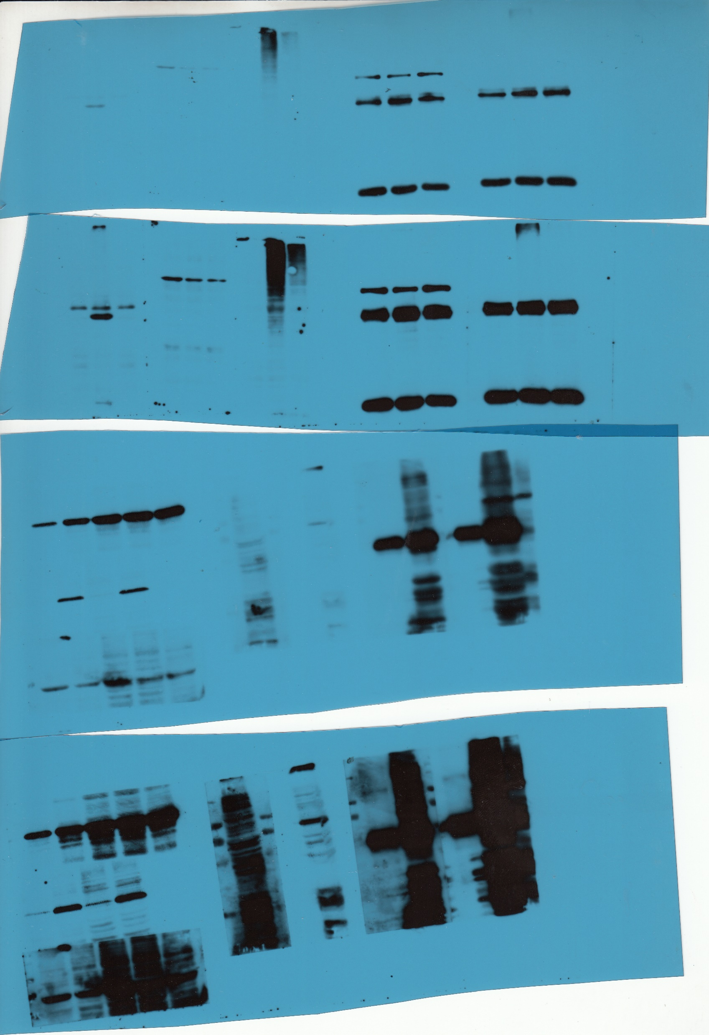
Fig3 C
AKT
GAPDH

Slide 5
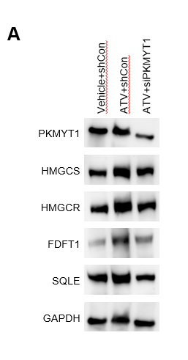


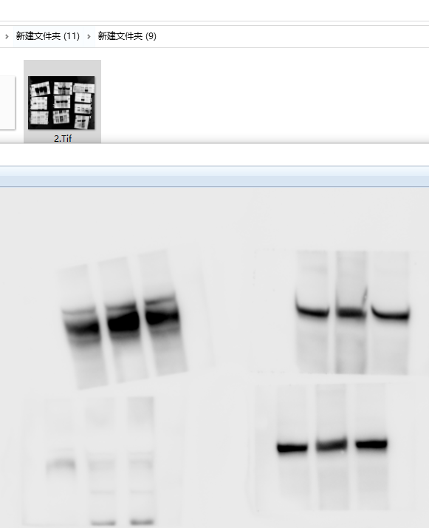
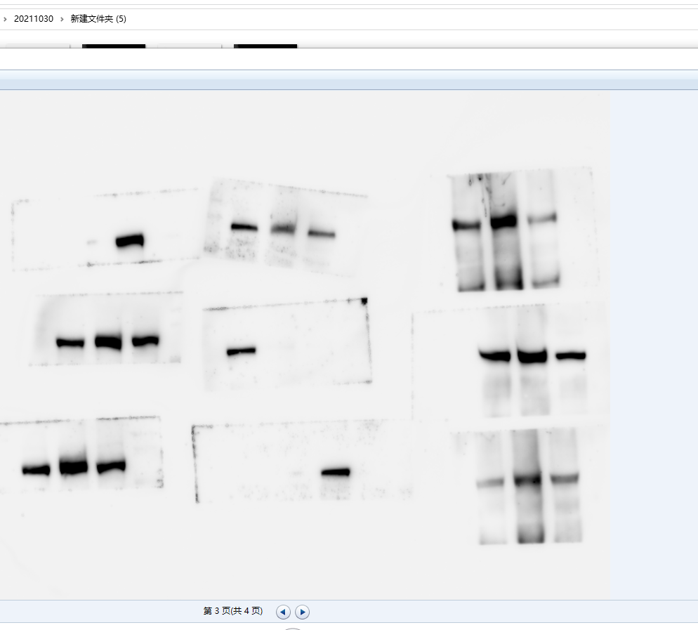
Fig4 A
DHCR24
HMGCS
SQLE
HMGCR
FDFT1
Vinculin

Slide 6
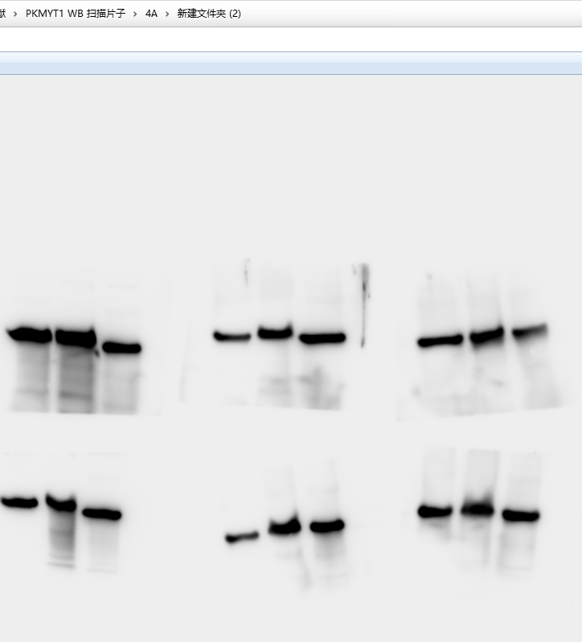
Fig4 A
GAPDH
PKMYT1

